Slide 1
Quanvolutional neural network
5/3/2022
https://arxiv.org/abs/1904.04767
https://arxiv.org/abs/2108.00661.pdf

Slide 2
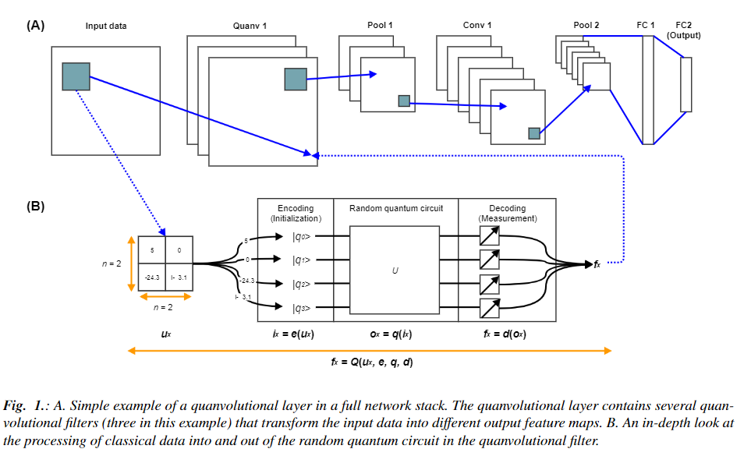
Overall structural

Slide 3
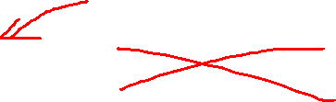
Models
QNN model
CNN model
(look like Lenet)
Image: 28x28x1
Image: 28x28x1
Quanv1: 3x3 random number of filters
Conv1: 50 5x5 filter
Conv1: 50 5x5 filter
Pool1
Pool1
Conv2: 64 5x5 filter
Conv2: 64 5x5 filter
Pool2
Pool2
FC1: 1024. Dropout = 0.4
FC1: 1024. Dropout = 0.4
FC2: 10. Droput = 0.4
FC2: 10. Droput = 0.4

Slide 4
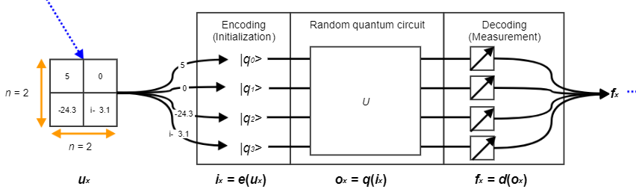
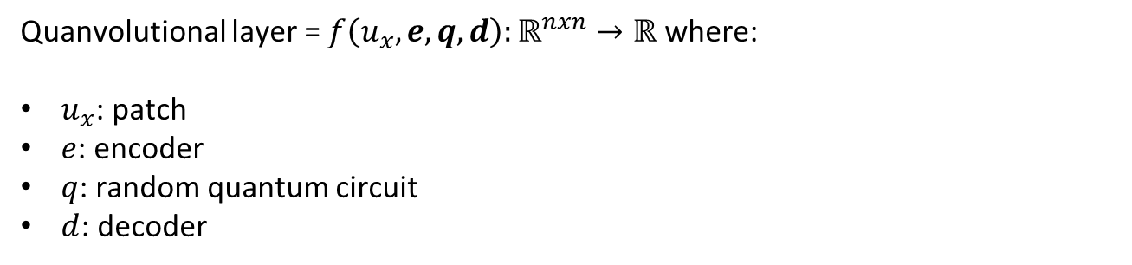
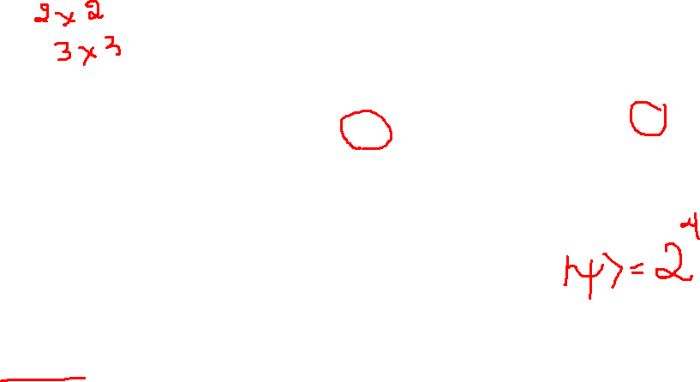
Quanvolutional layer
Quanvolutional layer = $f\left(u_{x},e,q,d\right):ℝ^{nxn}→ℝ$ where:
$u_{x}$: patch
$e$: encoder
$q$: random quantum circuit
$d$: decoder

Slide 5

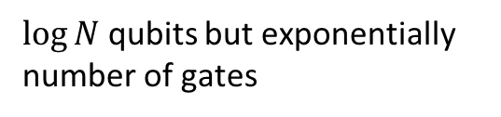
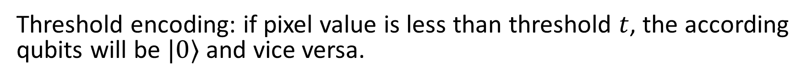
Encoding & Decoding
$\log{N}$ qubits but exponentially number of gates
$e:ℝ^{nxn}→|ψ⟩$
Amplitude encoding
$N$ qubit, linear number of gate
Threshold encoding: if pixel value is less than threshold $t$, the according qubits will be $|0⟩$ and vice versa.
$d:\left|ψ\right\rangle →ℝ$

Slide 6
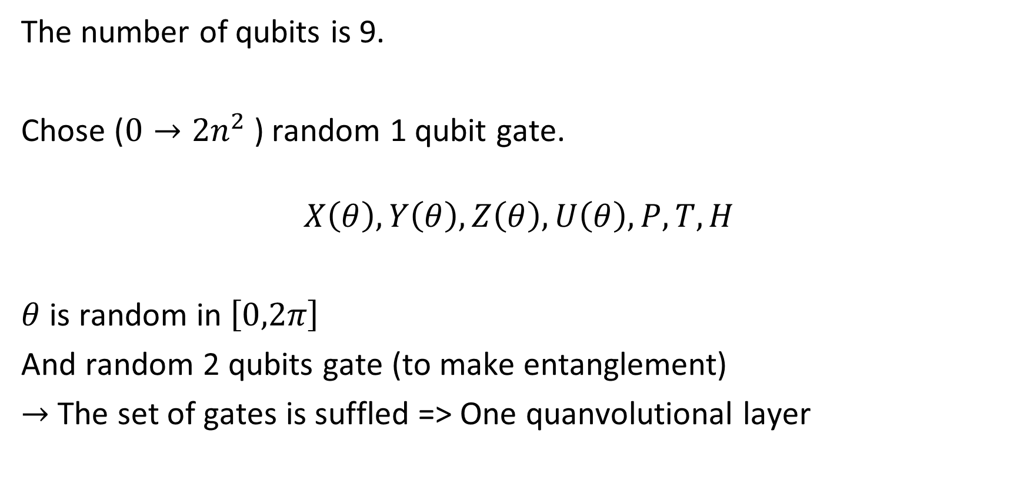
Quantum circuit
The number of qubits is 9.
Chose ($0→2n^{2}$) random 1 qubit gate.
$$X\left(θ\right),Y\left(θ\right),Z\left(θ\right),U\left(θ\right),P,T,H$$
$θ$ is random in $\left[0,2π\right]$
And random 2 qubits gate (to make entanglement)
$→$ The set of gates is suffled => One quanvolutional layer

Slide 7
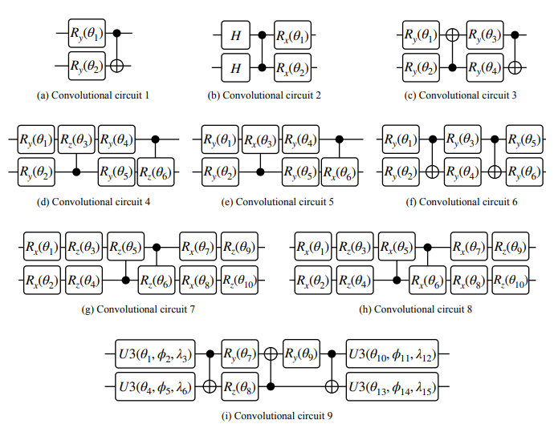
Quantum circuit: Example

Slide 8
Quantum advantages
Quantum computers can access kernel functions in highdimensional Hilbert spaces much more efficiently than classical computers.
=> Coverage faster

Slide 9

Disadvatanges
Number of measurements
Number of quanvolutional filters

Slide 10
Dataset
70k 28x28 gray MNIST samples (60k train, 10k test)

Slide 11
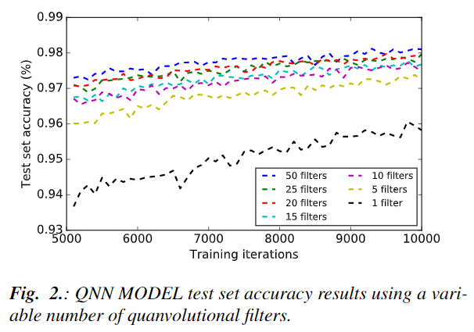
Results

Slide 12
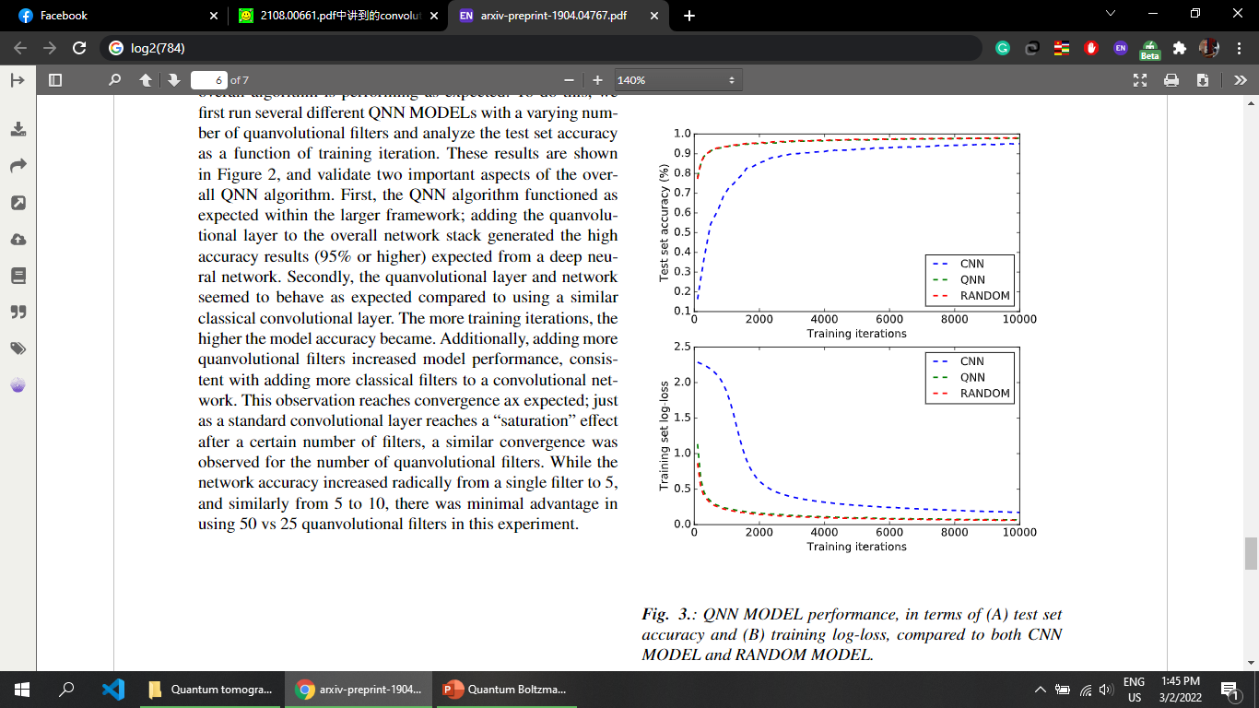
Results

Slide 13

Future works
Test on another dataset and deeper QNN.
Make quanvolutional layer trainable or change by time by the evolutional algorithm. => Use QNG in Quanvolutional layer

Slide 14
Thanks for listening!

